Slide 1
Project Review
Assistant to the person : Medical Supervision
Detection of the fall of the person and false alert check

Slide 2
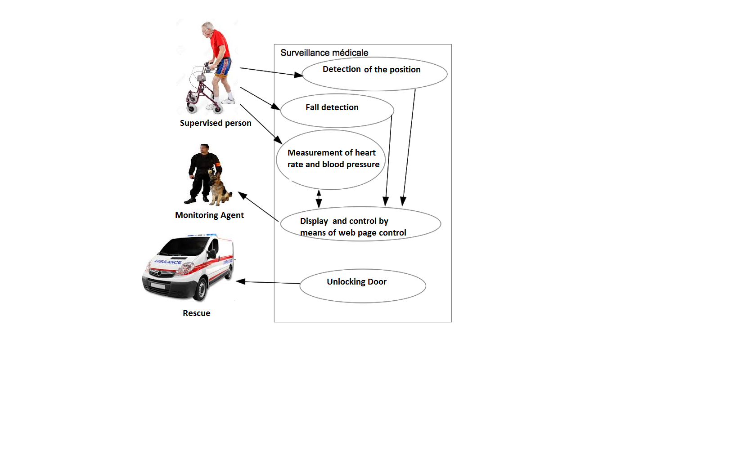

Slide 3
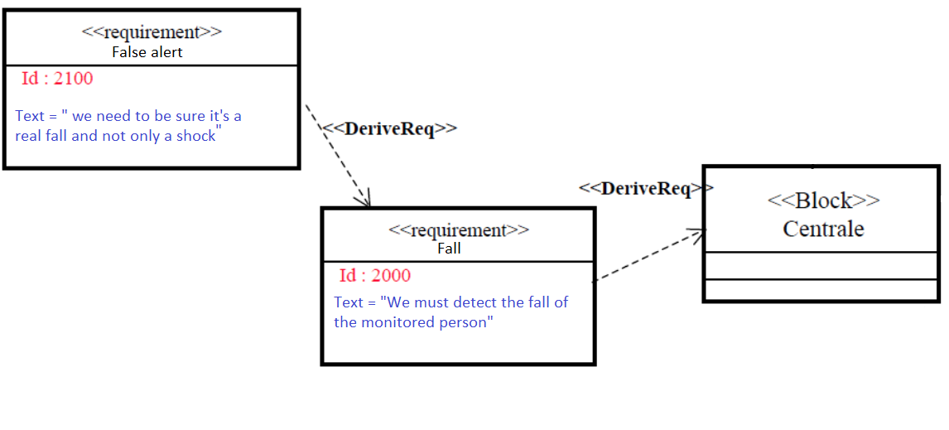

Slide 4
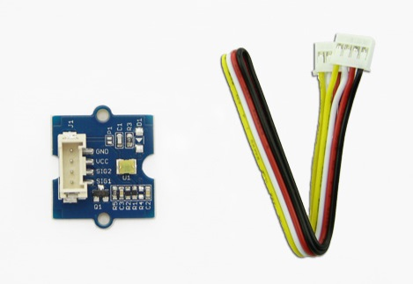
Solution

Slide 5
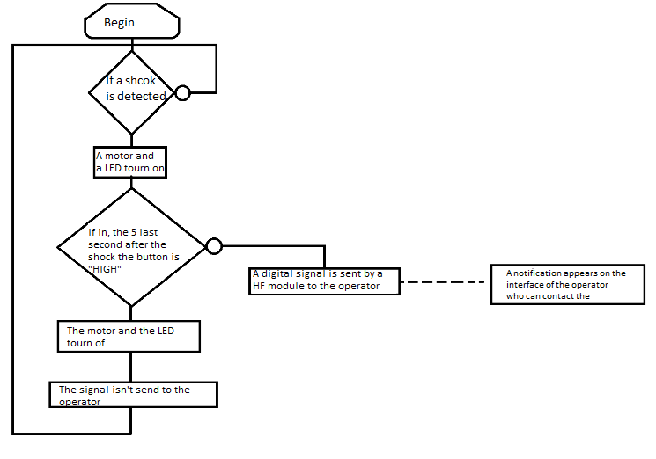

Slide 6
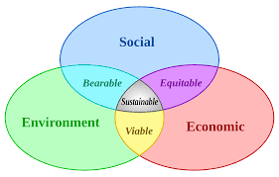
Sustainable development

